Slide 1

BLDEA’s
Dr.P G Halakatti college of Engineering and Technology
DEPARTMENT OF COMPUTER
SCIENCE AND ENGINEERING
Project Phase-2
“Malaria Parasite Detection by Image Processing of Blood Smear Images”
Team :
Krishna p(2BL16CS032)
Madhura J (2BL16CS036)
Mamata k(2BL16CS041)
Malati S (2BL16CS042)
Project guide:
Dr. Prema T. Akkasaligar

Slide 2
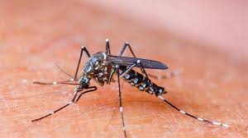
ABSTRACT:
Malaria is a common but serious protozoan disease caused by peripheral blood, spleen or liver parasites of the genus Plasmodium. It is estimated that approximately 781,000 people of the 225 million people infected worldwide by the disease succumb to this menace annually. The key to effective management of malaria lies in prompt and accurate diagnosis of the disease.

Slide 3
Contents:
INTRODUCTION
LITERATURE SURVEY
MOTIVATION
OBJECTIVES
PROBLEM STATEMENT
ARCHITECTURE OF PROPOSED SYSTEM
IMLEMENTATION
TOOLS AND TECHNOLOGY
CONCLUSION
REFERENCES

Slide 4
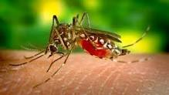
INTRODUCTION:
Malaria is disease the most common in the world and is caused by mosquito bites anywhere.
Malaria is one of the most common infectious diseases and a great public health problem worldwide, particularly in Africa and south Asia.
According to the World Health Organization, it caused more than 1 million deaths arising from approximately 300 to 500 million infections every year, mostly in children under five years of age.

Slide 5
LITERATURE SURVEY
TITLE | METHODOLOGY | ADVANTAGES AND DISADVANTAGES
1) “Recognition and classification of malaria plasmodium diagnosis”. | Edge detection algorithm and Binary with threshold. | This technique can detect the existence of malaria parasite within seconds .
2) “Morphological Segmentation of Blood Images”. | Color channel based algorithm. | Faster, accessible diagnosis of patients. Side effect of merging the information present in the separate color channels of the original RGB image.

Slide 6
LITERATURE SURVEY
TITLE | METHODOLOGY | ADVANTAGES AND DISADVANTAGES
3) “Current strategies to avoid misdiagnosis of malaria”. | Hemozoin Detection method. | Expensive equipments.
4) “Unsupervised Identification of malaria parasite using computer vision”. | K-Means Clustering. | It incorporates low level features such as color extraction. Better clustering results.

Slide 7
LITERATURE SURVEY
TITLE | METHODOLOGY | ADVANTAGES AND DISADVANTAGES
5)”Detection of plasmodium parasites from image of thin blood smears”. | Zack’s Algorithm. | Accurate and well trained. Time Consuming.
6) “Malaria parasite classification using Recurrent Network”. | Pattern Recognition Algorithm. | Accuracy is high.

Slide 8
LITERATURE SURVEY
TITLE | METHODOLOGY | ADVANTAGES AND DISADVANTAGES
7) “PCR- Based Method to diagnosis of imported malaria”. | PCR Algorithm. | Faster User friendly.
8) “Malaria parasite identification on thick blood films using genetic programming”. | Genetic programming Algorithm. | Accuracy is 95%. Classification with two classification rather than six classifications.

Slide 9
LITERATURE SURVEY
TITLE | METHODOLOGY | ADVANTAGES AND DISADVANTAGES
9) “Segmentation Based Approach to Detect Parasites and RBCs in Blood Cell Images”. | Parasite identification and RBC count. | Requires less time But for available database image, the relevant data is not available so it becomes difficult for us to evaluate our approach.
10) “Malaria Parasite Detection in Peripheral Blood Images”. | 2 consecutive classifications: stained/non-stained pixel classification and parasite/nonparasite classification. | Stained pixel classifier achieves satisfactory results.

Slide 10
LITERATURE SURVEY
TITLE | METHODOLOGY | ADVANTAGES AND DISADVANTAGES
11) ”Object Detection Technique For Malaria Parasite In Thin Blood Smear Images”. | K-means clustering algorithm | Enhances the detection performance of infected malaria parasites in thin blood smear images.
12) “Identification of Giemsa Stained of Malaria Using K-Means Clustering Segmentation Technique”. | K-means clustering algorithm can be combined with segmentation technique. | Automated Identification.

Slide 11
LITERATURE SURVEY
TITLE | METHODOLOGY | ADVANTAGES AND DISADVANTAGES
13)”Malaria Disease Identification and Analysis using Image Processing”. | Support vector machine and Neural Network. | Unsupervised nature . Robust.
14) “Detection and Analysis of malarial parasite using microscopic images”. | Support vector machine and Neural Network. | Valuable approach. Accurate. Error in wrong decision.

Slide 12
LITERATURE SURVEY
TITLE | METHODOLOGY | ADVAANTAGES AND DISADVANTAGES
15) “Automated status identification of microscopic images obtained from malaria thin blood smears”. | OTSU’S method. | Proper screening. It needs some improvement for the diagnosis.
16) “Color image segmentation approach for the detection of malaria parasites using various color models and K-Means Clustering”. | K-Means Clustering Algorithm. | Smoother images. Best in obtaining fully segmented cells. Difficult to determine the threshold values.

Slide 13
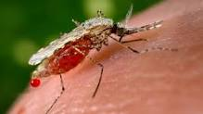
Motivation:
Half of world population is at risk of life threatening infectious disease Malaria. It is a parasitic disease of both human and animals and causes 219, 216 million infection cases of malaria and killed 6.6, 6.5 million people in 2010 and 2011 respectively. The major population that is at high risk mainly includes pregnant women and children who especially under five years.
This alarming situation has led the researchers to develop a rapid, accurate and affordable diagnostic method for early malaria parasite detection . Patient suffering from malaria disease should be diagnosed at early stage and should be given an effective and affordable treatment within 24 hours .

Slide 14
OBJECTIVES:
Identification of malaria must be done rapidly so that
treatment is not delayed.
The CNN technique can used to automate identification of blood image infected of malaria, can help to identify the image of the affected blood directly of malaria.
To obtain an accurate, speedy and affordable system of malaria detection using stained thin blood smear images is developed.
Automatic malarial parasite analysis and classification

Slide 15
Problem definition:
Malaria is a life-threatening disease caused by parasites that are transmitted to people through the bites of infected female Anopheles mosquitoes. It is preventable and curable.
Malaria must be recognized promptly in order to treat the patient in time and to prevent further spread of infection in the community via local mosquitoes. Malaria should be considered a potential medical emergency and should be treated accordingly. Delay in diagnosis and treatment is a leading cause of death in malaria patients in the United States.
Diagnosis of malaria can be difficult:
here malaria is not endemic any more health-care providers may not be familiar with the disease. Clinicians seeing a malaria patient may forget to consider malaria among the potential diagnoses and not order the needed diagnostic tests. Laboratorians may lack experience with malaria and fail to detect parasites when examining blood smears under the microscope.
In some malaria-endemic areas, malaria transmission is so intense that a large proportion of the population is infected but not made ill by the parasites. Such carriers have developed just enough immunity to protect them from malarial illness but not from malarial infection. In that situation, finding malaria parasites in an ill person does not necessarily mean that the illness is caused by the parasites.

Slide 16
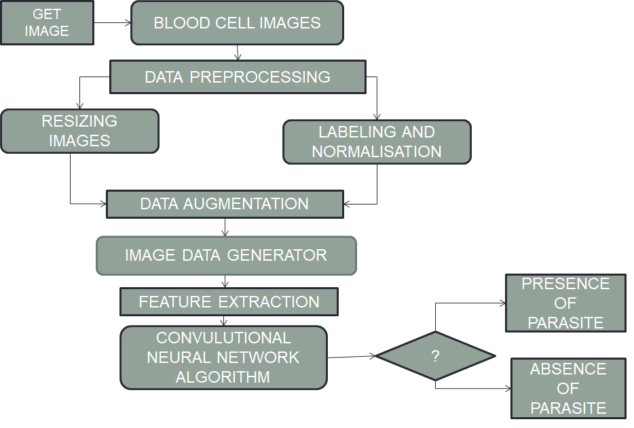
ARCHITECTURE OF PROPOSED SYSTEM

Slide 17
IMLEMENTATION
The proposed method is a 4 stage method that consist of following sub tasks:
1. Get image
2. Data Preprocessing
3. Data Augmentation
4. Feature Extraction

Slide 18
Get image
We use the ‘OS’ library from python to get the images.The specific method used is
os.listdir() . The following are the tasks of list directory method
Return a list containing the names of the entries in the directory given by path. The list is in arbitrary order, and does not include the special entries '.' and '..' even if they are present in the directory.
path may be a path-like object. If path is of type bytes (directly or indirectly through the PathLike interface), the filenames returned will also be of type bytes; in all other circumstances, they will be of type str.
This function can also support specifying a file descriptor; the file descriptor must refer to a directory.
Raises an auditing event os.listdir with argument path.

Slide 19
Data Pre-processing
Data preprocessing and labeling is pretty straightforward.In order to preprocess our data we use two methods :
Scaling
Scaling is just resizing of the image. OpenCV comes with a function cv2.resize() for this purpose. The size of the image can be specified manually, or you can specify the scaling factor.
Everything what we have done is resizing to 50x50 images.
Labelling
Labelling is assigning a label to each image here we label the image as 0 and 1.Where 0 refers to as the uninfected class and 1 refers to Parasitized images

Slide 20
Data Augmentation
Data augmentation encompasses a wide range of techniques used to generate “new” training samples from the original ones by applying random jitters and perturbations (but at the same time ensuring that the class labels of the data are not changed).
The type of data augmentation we use is called in-place data augmentation or on-the-fly data augmentation. This type of data augmentation is what Keras’s ”ImageDataGenerator” class implements.

Slide 21
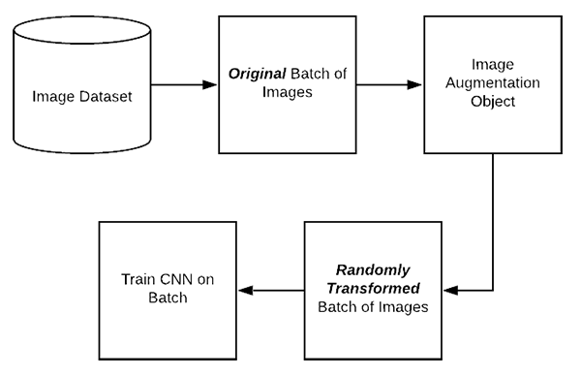
Data Augmentation
Figure 2.Working of Data Augmentation in keras

Slide 22
Data Augmentation
Figure(2) demonstrates the process of applying in-place data augmentation:
Step 1: An input batch of images is presented to the ImageDataGenerator
.
Step 2: The ImageDataGenerator
transforms each image in the batch by a series of random translations, rotations, etc.
Step 3: The randomly transformed batch is then returned to the calling function.

Slide 23
Feature Extraction
The algorithm used here is CNN (Convolutional Neural Network)
The Keras library in Python makes it pretty simple to build a CNN.
There are basically five steps in building a CNN model namely:
Data pre-processing
Building the model
Compiling the model
Training the model
Using our model to make predictions

Slide 24
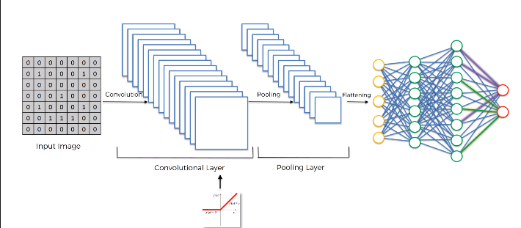
Feature Extraction
The total steps within a building of a CNN

Slide 25
Data pre-processing
We have accomplished this task in the previous stages
Building the model
CNN built for image recognition is a simple CNN with two CONV => RELU => POOL => CONV => RELU layers and single fully connected layer.
We have also used BatchNormalization layer after each RELU activation making our network train faster, converage more quickly and making activation function more viable.

Slide 26
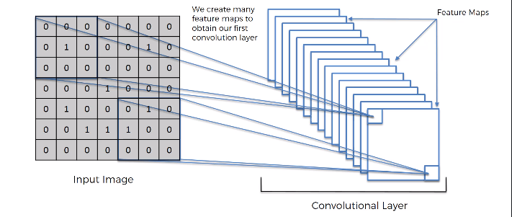
Building the model
The model type that we will be using is Sequential. Sequential is the easiest way to build a model in Keras. It allows you to build a model layer by layer.
Conv2D:
Our first layer is Conv2D layers. These are convolution layers that will deal with our input images, which are seen as 2-dimensional matrices.
32 in the first layer are the number of nodes in each layer.

Slide 27
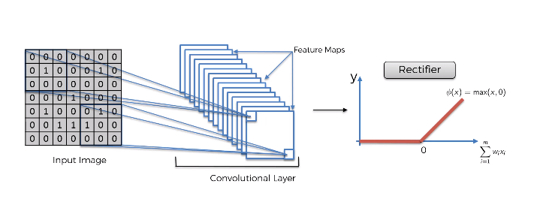
Building the model
Activation(ReLU):
Activation is the activation function for the layer. The activation function we will be using for our first 2 layers is the ReLU, or Rectified Linear Activation.
This activation function has been proven to work well in neural networks.
ReLU helps in reducing or completely removing the linearity in our images

Slide 28
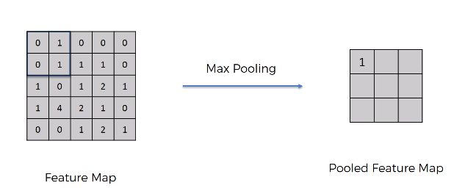
Building the model
POOLING:
This the stage where the maximum value of a 2x2 value matrix is reduced to one.
The method where 75% of unnecessary data is reduced and the important 25% is used.

Slide 29
Building the model
BatchNormalization:
Batch normalization reduces the amount by what the hidden unit values shift around
We can use higher learning rates because batch normalization makes sure that there’s no activation that’s gone really high or really low.
It reduces overfitting because it has a slight regularization effects. Similar to dropout, it adds some noise to each hidden layer’s activations.
Dropout:
Dropout is used for regularization of the training data.

Slide 30
Compiling the model
Compiling the model takes three parameters: optimizer, loss and metrics.
The optimizer controls the learning rate. We will be using ‘adam’ as our optmizer. Adam is generally a good optimizer to use for many cases. The adam optimizer adjusts the learning rate throughout training.
We will use ‘categorical_crossentropy’ for our loss function. This is the most common choice for classification. A lower score indicates that the model is performing better.
To make things even easier to interpret, we will use the ‘accuracy’ metric to see the accuracy score on the validation set when we train the model.

Slide 31
Training the model
Now we will train our model. To train, we will use the ‘fit_generator()’ function on our model with the following parameters: training data (train_X), target data (train_y), validation data, and the number of epochs.
The number of epochs is the number of times the model will cycle through the data.
After 30 epochs, we have gotten to 95.87% accuracy on our validation set.
Using our model to make predictions
If you want to see the actual predictions that our model has made for the test data, we can use the predict function.

Slide 32
TOOLS AND TECHNOLOGY:
Hardware Requirements:
Operating system : Windows 7 or 10.
Tool : Anaconda (Jupyter Notebook)
Software Requirements:
Software : Python 3.6
Dependency : numpy, opencv
Libraries : pandas, matplotlib, keras, tensor flow, scipy, sklearn

Slide 33
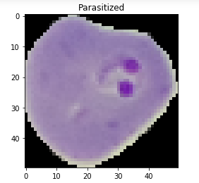
Results:
Correct predictions for the test data - parasitized

Slide 34

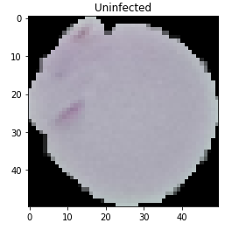
Correct predictions for the test data - Uninfected

Slide 35
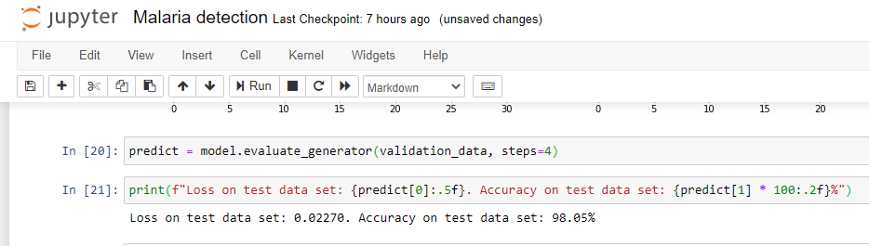
Accuracy level

Slide 36
CONCLUSION:
In this project we aim to classify the blood smear image as whether the malaria parasite is present or not.
We initially get the image from the datasets and preprocess the image by screening the noise cancellation and normalizing.
The preprocessed image is then used in background subtraction method for Segmentation. The foreground objects get deprive of the background image for every pixel. And further sent for feature extraction.
In feature extraction we are going to use Convolution Neural Network algorithm to classify whether the blood smear images consist of malaria parasite or not. Based on the literature survey we can conclude that the above mentioned methods are best suited for detection and analysis of malaria.

Slide 37
REFERENCES:
[1]. E.Komagal et al.”Recognition And Classification Of Malaria Plasmodium Diagnosis”, International Journal of Engineering Research & Technology (IJERT)Vol. 2 Issue 1, January- 2013ISSN: 2278-0181.
[2]. Florian Biermann.”Morphological Segmentation of Blood Images for Automated Malaria Diagnosis” , November 26, 2013.
[3]. T.HaÈnscheid “Current strategies to avoid misdiagnosis of malaria” ß2003 Copyright by the European Society of Clinical Microbiology and Infectious Diseases.
[4]. Nazeed khan et al. ”Report: Unsupervised identification of malaria parasites using computer vision”, Article in Pakistan journal of pharmaceutical sciences · January 2017 Pak. J. Pharm. Sci., Vol.30, No.1, January 2017, pp.223-228.
[5]. Daniel Maitethia Memeu et al. ”Detection of plasmodium parasites from images of thin blood smears”, Copyright © 2013 Daniel Maitethia Memeu et al. This is an open access article distributed under the Creative Commons Attribution License, which permits unrestricted use, distribution, and reproduction in any medium, provided the original work is properly cited. Open Journal of Clinical Diagnostics 3 (2013) 183-194.

Slide 38
REFERENCES:
[6]. Muhammad Imran Razzak et al.”Malarial Parasite Classification using Recurrent Neural Network”, International Journal of Image Processing (IJIP), Volume (9) : Issue (2) : 2015.
[7]. BERRY A.* et al “PCR-BASED METHODS TO THE DIAGNOSIS OF IMPORTED MALARIA”, 2008, 15, pp.484-488.
[8]. Ketut Eddy Purnama et al. ” Malaria Parasite Identification on Thick Blood Film Using Genetic Programming”, 2013 3rd International Conference on Instrumentation, Communications, Information Technology, and Biomedical Engineering (ICICI-BME)194Bandung, November 7-8, 2013. pp.194-198
[9]Lalit B. Damahe ,R. K. Krishna,N. J. Janwe, Dr. Thakur Nileshsingh V.et al“Segmentation Based Approach to Detect Parasites and RBCs in Blood Cell Images”- International Journal Of Computer Science And Applications Vol. 4, No. 2, June July 2011 ISSN: 0974-1003. pp.71-81
[10] F. Boray Tek , Andrew G. Dempster and Izzet Kale et al “Malaria Parasite Detection in Peripheral Blood Images”- University of Westminster, Dept. Electronic Systems,
Applied DSP & VLSI Research Group, London, UK. pp.245-268

Slide 39

[11]P.A. Pattanaik, Tripti Swarnkar, Debdoot Sheet et al “Object Detection Technique For Malaria Parasite In Thin Blood Smear Images” ,2017 IEEE International Conference on Bioinformatics and Biomedicine (BIBM).pp.2120-2123.
[12] Edy Victor Haryanto S, M. Y. Mashor, A.S. Abdul Nasir, Zeehaida Mohamed et al,”Identification of Giemsa Staind of Malaria Using K-Means Clustering Segmentation Technique” ,The 6th International Conference on Cyber and IT Service Management (CITSM 2018),Inna Parapat Hotel – Medan, August 7-9, 2018.
[13]. Sneha Narayan Chavan et al. ”Malaria Disease Identification And Analysis Using Image Processing” international Journal of Latest Trends in Engineering and Technology (IJLTET) Vol. 3 Issue 3 January 2014 ISSN: 2278-621X. pp.218-223
[14]. Ashok Sutkar et al. ”Detection and Analysis of Malarial Parasites Using Microscopic Images” IJCAT - International Journal of Computing and Technology, Volume 1, Issue 11, December 2014 ISSN : 2348 – 6090. pp.605-610.
[15]. Dian Anggraini et al. ”Automated Status Identification of Microscopic Images Obtained from Malaria Thin Blood Smears”, 2011 International Conference on Electrical Engineering and Informatics 17-19 July 2011, Bandung, Indonesia.
[16]. AIMI SALIHAH ABDUL-NASIR et al. ”Colour Image Segmentation Approach for Detection of MalariaParasites Using Various Color Models and k-Means Clustering” E-ISSN: 2224-2902 Issue 1, Volume 10, January 2013. pp.41-55.

Slide 40


